Slide 1
HL-2000-LL-FHSA/
HL-2000-LL/
HL-2000-HP/
HL-2000-HP-FHSA
Ocean Optics Spectrometer Illuminator

Slide 2
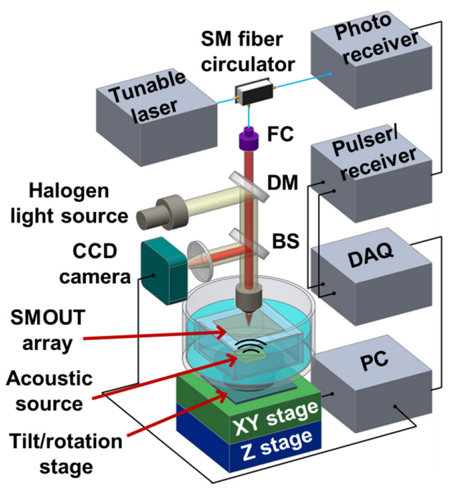
Title: A high-frequency surface-micromachined optical ultrasound transducer (SMOUT) array for 3D micro photoacoustic computed tomography (µPACT)
Paper 1
Objective of the paper (with Sample): The main objective of this work is to develop and validate a 2D high-frequency surface-micromachined optical ultrasound transducer (HF-SMOUT) array for micro-photoacoustic computed tomography (µPACT). To evaluate the 3D imaging capability and spatial resolution of the HF-SMOUT array human hair is used.
Layout (figure):
Components used to make it
1. Collimate: Here fiber-coupled laser is used as light source to generate photacoustic (PA) wave and fiber collimator (F810APC-780, Thorlabs) is used for collimation. And to have spatial resolution of the designed system, the light source HL-2000-LL is used for imaging the hair.
2. To make it focus: A 10X objective lens is used for focusing the light to the sample.
3. A beam sampler BSF10-A, Thorlabs is used to reflect the light from sample to detector
doi/link: Yan, Z., & Zou, J. (2024, March). A high-frequency surface-micromachined optical ultrasound transducer (SMOUT) array for 3D micro photoacoustic computed tomography (µPACT). In Photons Plus Ultrasound: Imaging and Sensing 2024 (Vol. 12842, pp. 11-16). SPIE.

Slide 3
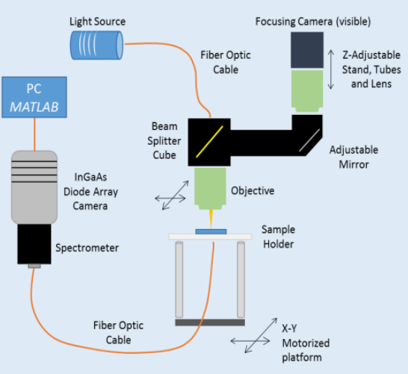
Title: Highly sensitive image-derived indices of water stressed plants using hyperspectral imaging in SWIR and histogram analysis
Paper 2
Objective of the paper (with Sample): To develop a hyperspectral imaging system operating in the Short-Wave Infrared Region (SWIR) (800–1600 nm) with high spectral resolution (1.56 nm/pixel) to capture detailed water absorption characteristics of plant leaves.
Layout (figure):
Components used to make it
Collimate: A halogen lamp (7 W, Ocean Optics, HL-2000) was coupled with a large-diameter NIR-rated optical fiber Ø1000 µm, 0.39 NA. The light through the sample was captured by another optical fiber (Ø400 µm, 0.48 NA, Thorlabs). No elements used for collimation is mentioned.
2. To make it focus: An objective lens UPLan FLN 20x/0.50 (Olympus) is used for focusing the light on the sample
doi/link: Kim, D. M., Zhang, H., Zhou, H., Du, T., Wu, Q., Mockler, T. C., & Berezin, M. Y. SUPPLEMENTARY INFORMATION Highly sensitive image-derived indices of water-stressed plants using hyperspectral imaging in SWIR and histogram analysis.

Slide 4
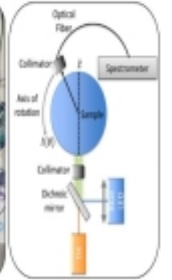
Title: Detecting Cyanobacteria and Inorganic Contaminants in Water by Full Scattering Profile Optical Spectroscopy
Paper 3
Objective of the paper (with Sample): To develop and validate a label-free, real-time optical sensing method based on Full Scattering Profile (FSP) measurements and the Iso-Pathlength (IPL) phenomenon for the simultaneous detection and quantification of multiple water contaminants (cyanobacteria and heavy metals) in mixed samples.
Layout (figure):
Components used to make it
1. Collimate: The light is coupled through a multimode optical fiber (M59L02-1000um-0.5NA, Thorlabs) and collimated (F220SMA-532, Thorlabs) before entering the medium. The collimated fiber coupling has 2.1 mm output beam diameter.
2. To make it focus: Not mentioned
doi/link: Fixler, D., Tzroya, A., Ram, E., Ben-Gershon, G., Shemesh, B., Abu-Ghosh, S., ... & Duadi, H. Detecting Cyanobacteria and Inorganic Contaminants in Water by Full Scattering Profile Optical Spectroscopy. Available at SSRN 5829408.

Slide 5
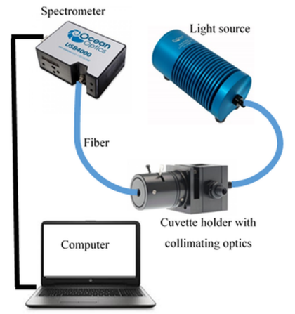
Title: Broadband spectroscopy for characterization of tissue-like phantom optical properties
Paper 4
Objective of the paper (with Sample): To characterize the optical properties of readily available, low-cost Parker black ink and Intralipid 20% as tissue-simulating absorbing and scattering materials for constructing biomedical optical phantoms in the visible spectral range .
Layout (figure):
Components used to make it:
It consists of broadband halogen tungsten light source (HL-2000-HP-FHSA, Ocean Optics Inc. FL), a fiber coupled cuvette holder with two collimating lenses (CUV-ATT-DA, Avantes Inc., Netherlands), and a USB portable spectrometer (USB4000 FL, Ocean Optics Inc.).
Reference: Shahin, A., & Bachir, W. (2017). Broadband spectroscopy for characterization of tissue-like phantom optical properties. Polish Journal of Medical Physics and Engineering, 23(4), 121-126.

Slide 6
Your Suggestion how to make it collimate up to which distance and whether it is applicable for our purpose?
Most of the people directly used optical fiber to couple the light beam from the light source for spectroscopic study. But in our case, we need a collimated beam. So, to have collimated light beam having 2-3 mm output beam diameter, F220SMA-532, Thorlabs will work well, if we use after the light source in our setup.

